Slide 1
Color Guessing Game
Lauren Powell & Joshlee Chery
COP 1500

Slide 2
Goals
02
The goal of the project is to make a Python-based Color Guessing Game that uses object-oriented programming, data structures, loops, functions, and exception handling to create an interactive user experience.

Slide 3
Software requirements
03
Python 3.13, Pycharm

Slide 4
Introduction
04
This project presents a Python-based Color Guessing Game that uses object-oriented programming, data structures, loops, functions, and exception handling to create an interactive user experience. Each color in the game is represented as an object containing a name and a list of associated real-world items that serve as hints. A player object tracks the user’s name, score, and guess history. The game allows the user to select a difficulty level, which determines the number of allowed attempts. During each round, the program randomly selects a color and provides object-based hints until the player correctly identifies the color or runs out of attempts. Overall, this program shows how multiple Python features can work together to build a functional and engaging game

Slide 5
Flow Diagram
Brainstorming
Meet up at Biscayne Hall
Creating the Game
Meet up at the Learning Hub
Meet up at Biscayne Hall
Creating The Reports
Finishing up

Slide 6
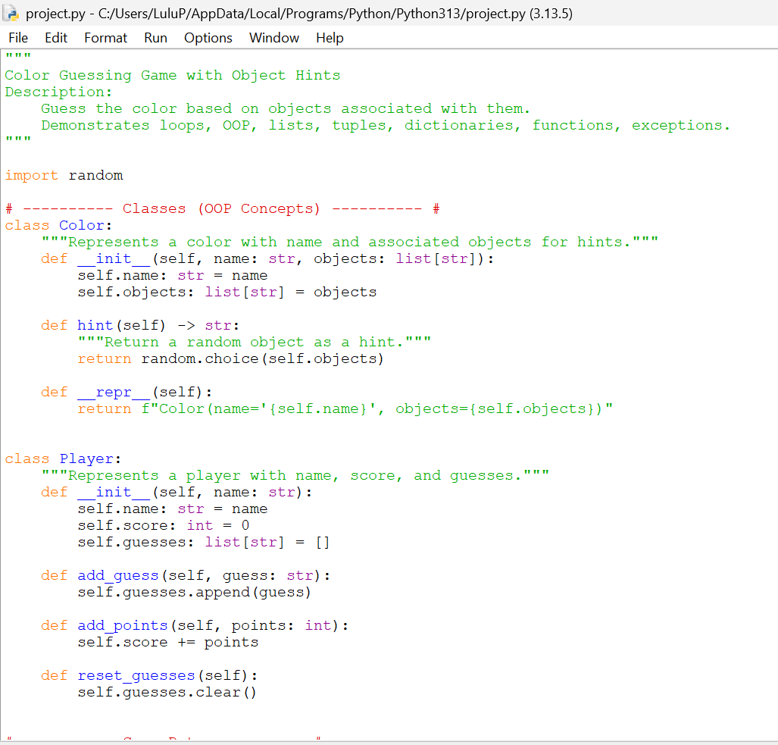
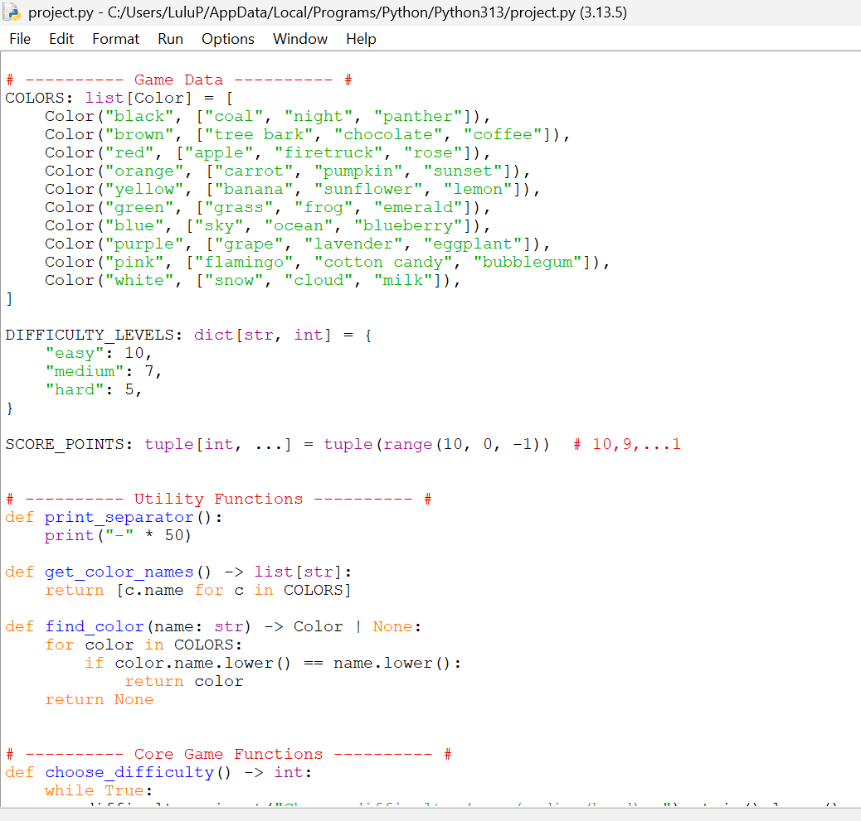
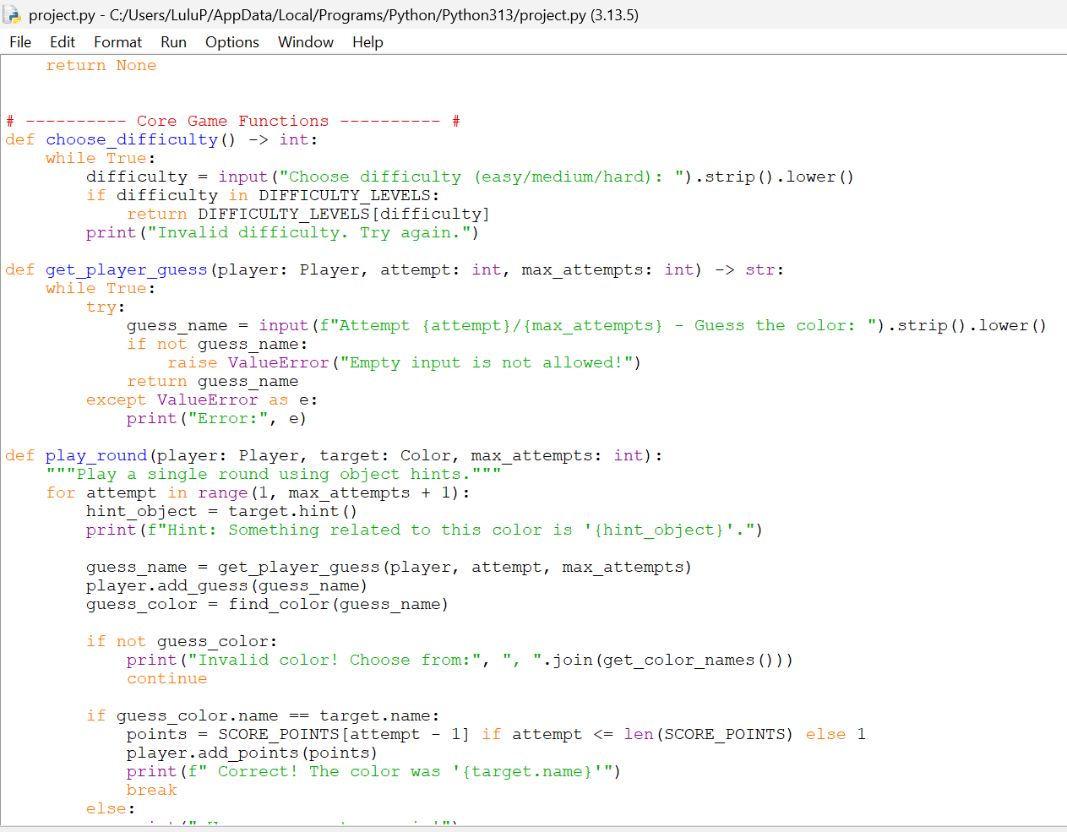
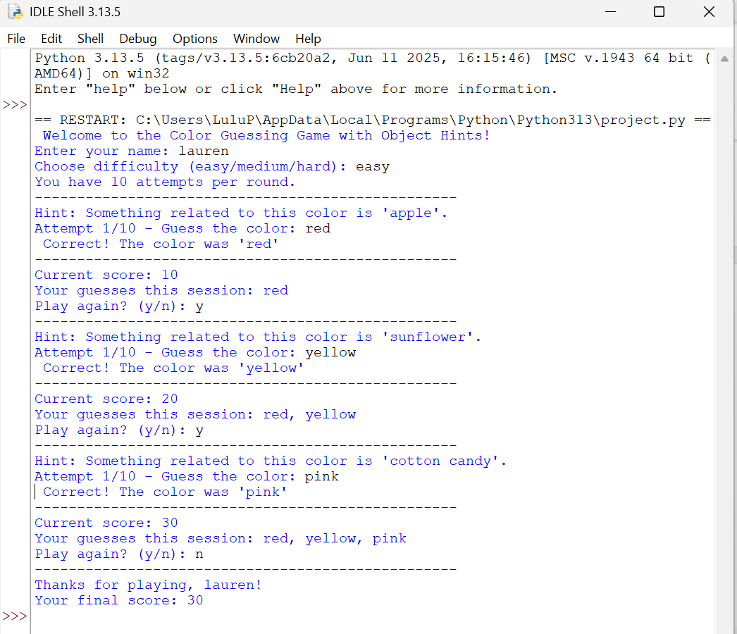
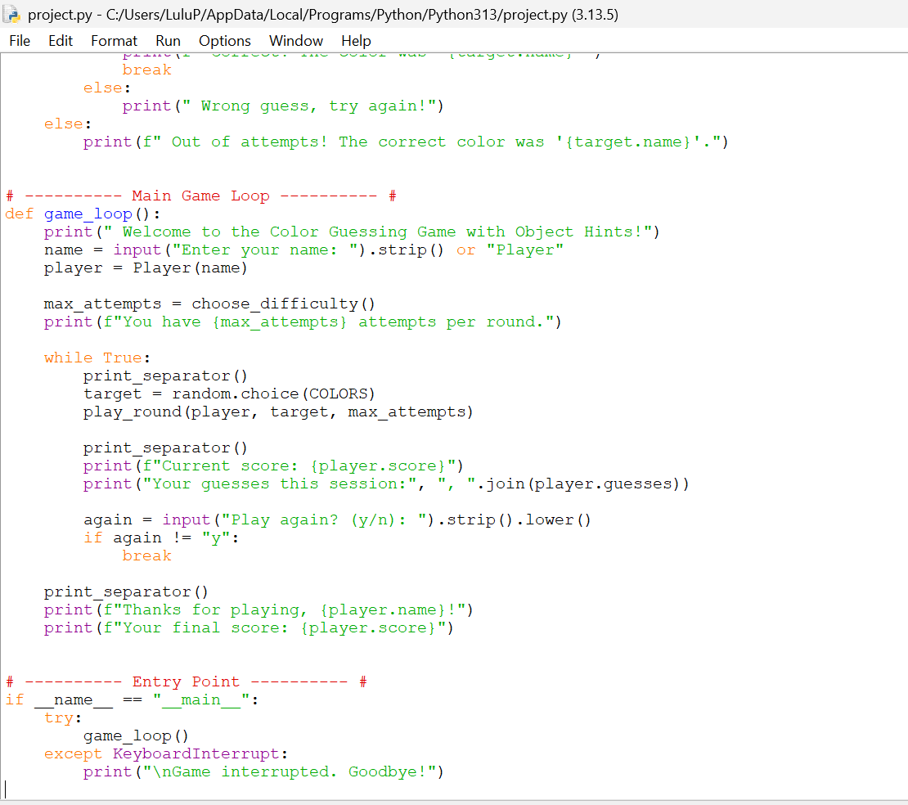
Screenshots
06

Slide 7
Discussion & Conclusion
Creating the Color Guessing Game in Python was a valuable learning experience for both of us. While the game successfully demonstrated object-oriented programming and interactive gameplay, we noticed some limitations, such as a basic console interface and a limited variety of hints, which could make repeated play less engaging. If we were to start over, we would focus on gathering feedback earlier in the process. Overall, the project highlighted the importance of thoughtful design, collaboration, and continuous improvement.

Slide 8
Appendix
07
The Learning Hub
Resource links
ChatGPT: used as a reference
https://github.com/laurenp211/randomnumbergenerator.git

